Slide 1
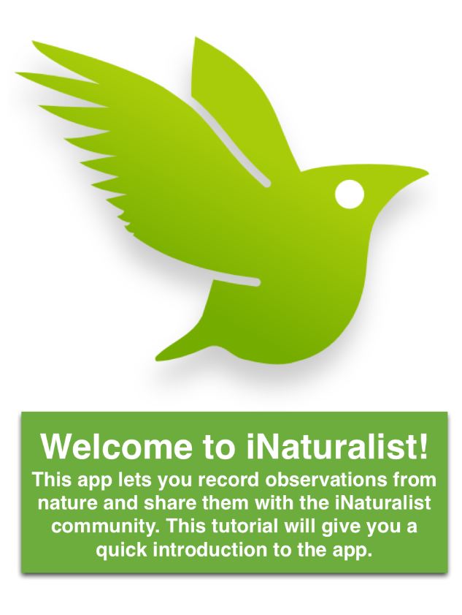

Slide 2
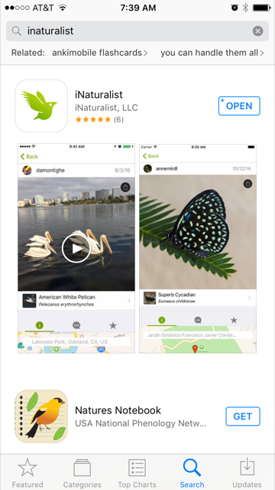
Getting the program:
You can:
- Download the app on your smart phone from the app store or
- sign into the program on iNaturalist.org

Slide 3
Once you create your account you can log into it from any devise that has the program
But first….. You have to create an account

Slide 4
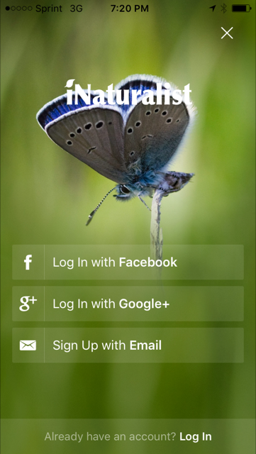
Use your Facebook, Google account or Email to create your account

Slide 5
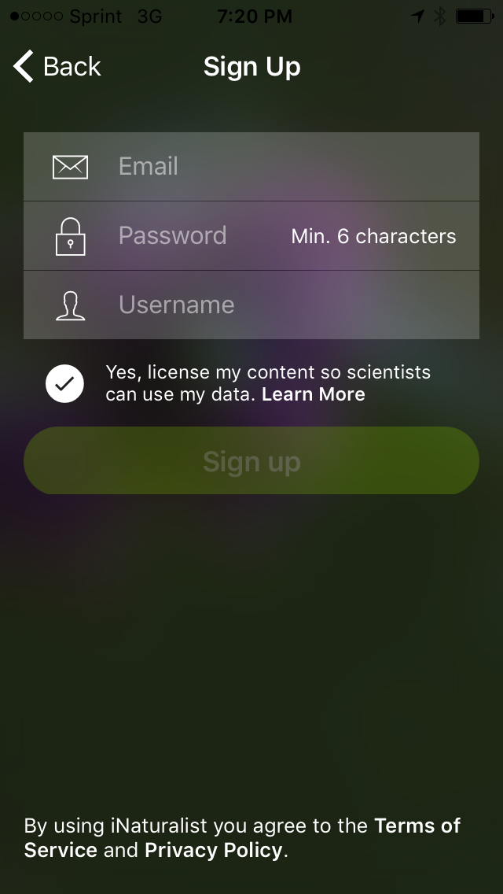
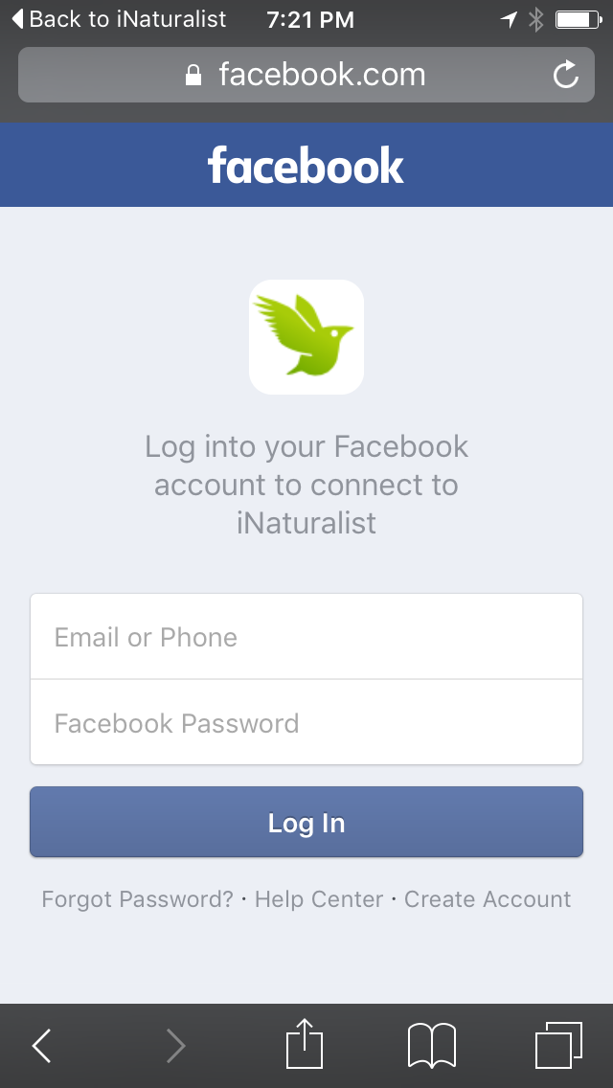
To create your account you will need:
-Password
-Username

Slide 6
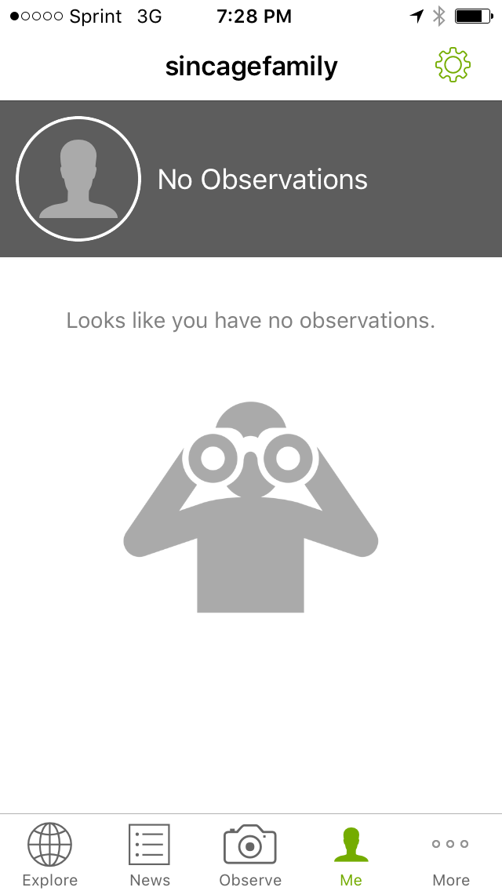
Once your account is set up you are ready to start adding observations.

Slide 7
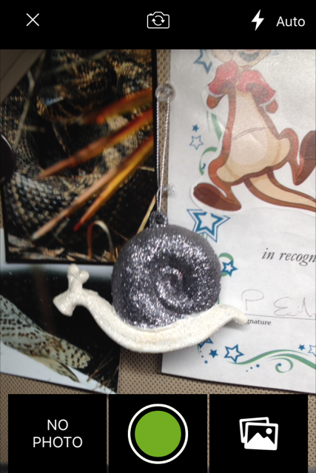
You have three choices:
You can add an observation with no photo.
You can take a photo and add it directly
Or you can get a photo from your camera roll.

Slide 8
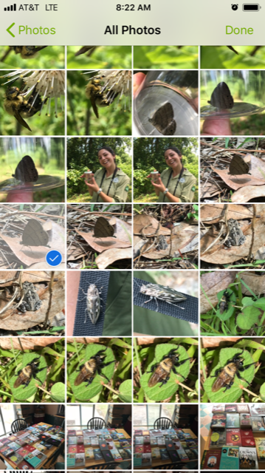
For selecting from your camera roll:
Just select your image and hit done.

Slide 9
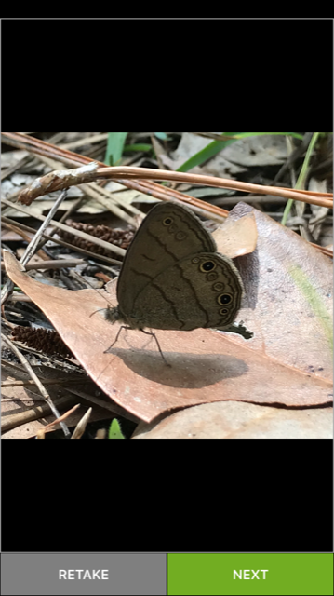

Slide 10
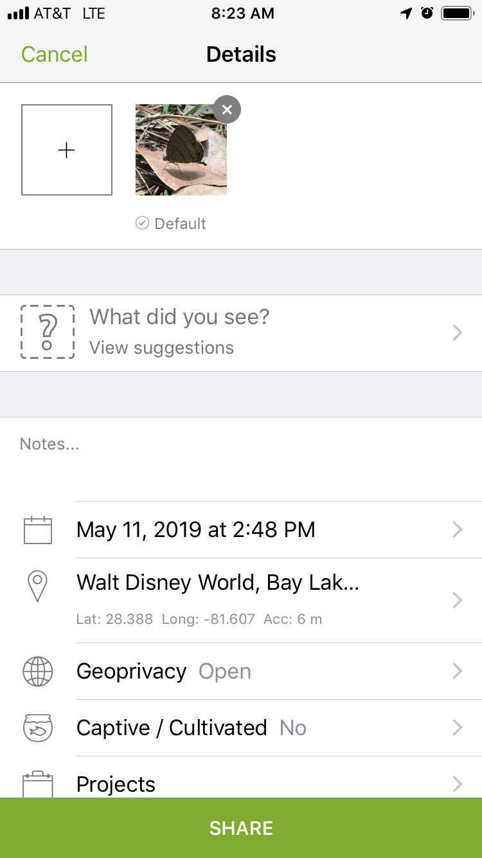
You can do a species search to help narrow down the identification if you do not know the exact species by clicking here

Slide 11
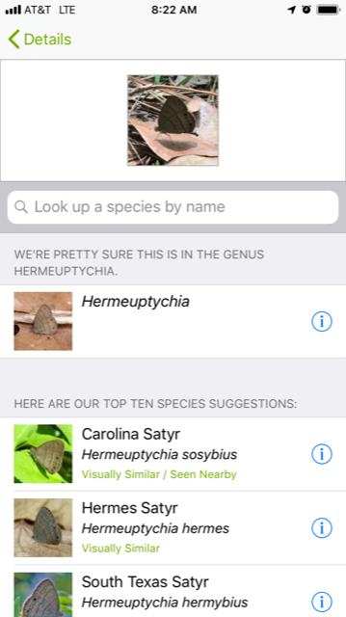
iNaturalist will give you ten potential species to pick from, starting with species see near by or visually similar.

Slide 12
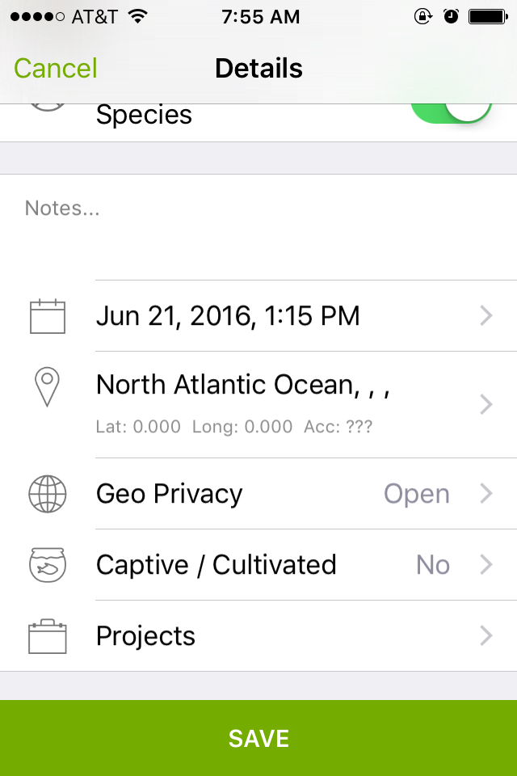
After identifying the species, the most important part of logging an observation is linking it to the BIOBLITZ project.
Select here

Slide 13
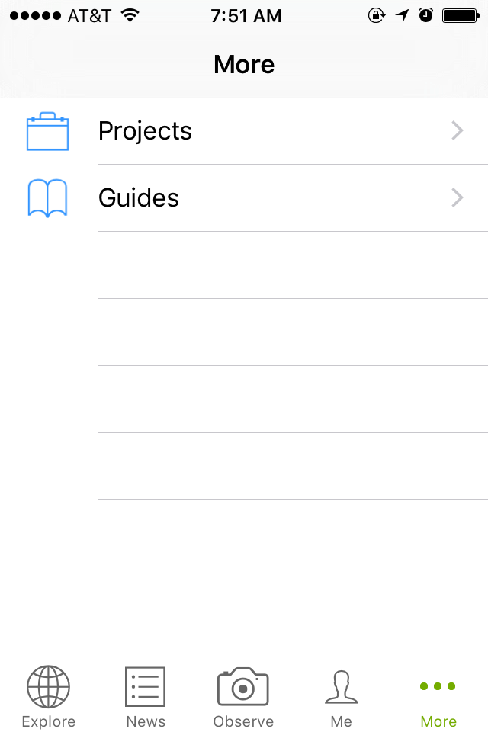
Select Project

Slide 14
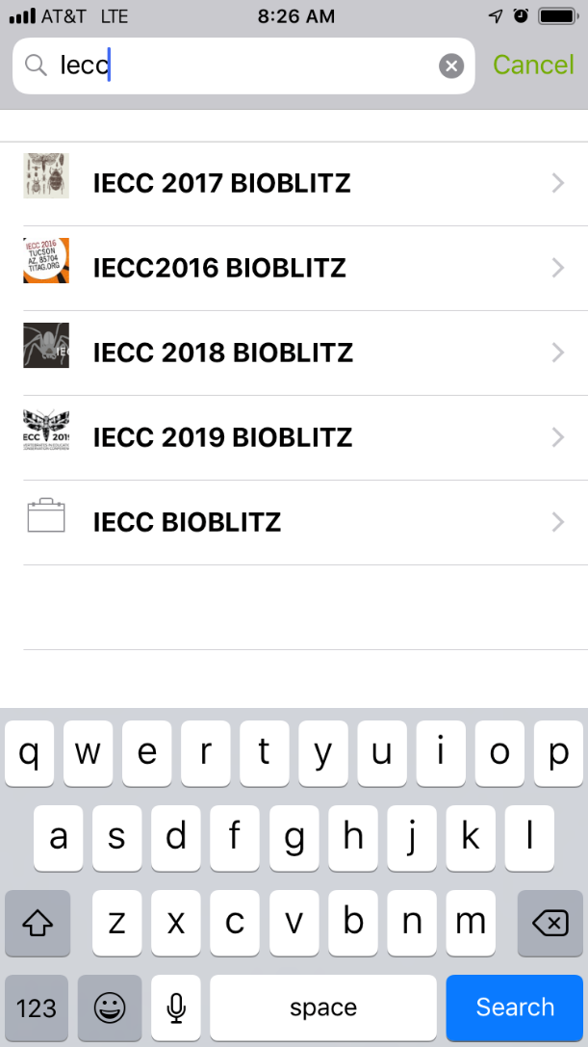
Type IECC in search
Select the appropriate bioblitz

Slide 15
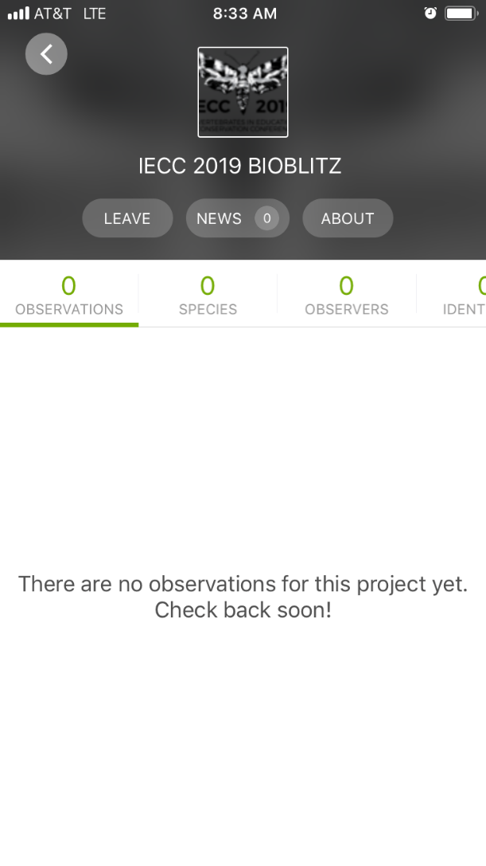
Join the project and add your observations

Slide 16
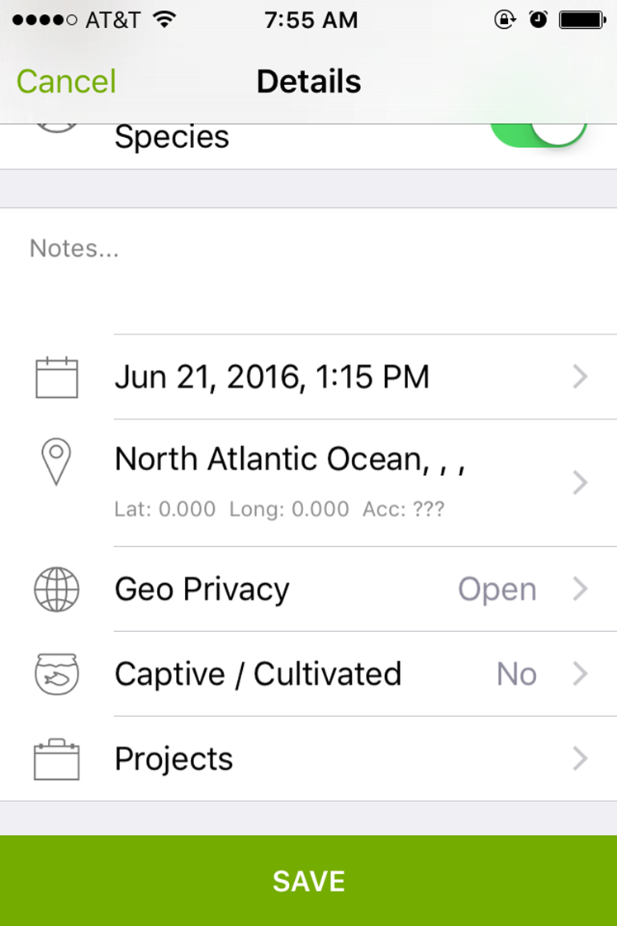
Don’t forget to save your observation and upload to iNaturalist!
Uploading requires a WIFI connection

Slide 17
An animal observation does not have to be of the actual animal. You can document an observation by webs, nests, frass or tracks.
Even a sound recording can count as an observation!

Slide 18

NO JOKING AROUND …
Please only submit actual observations
You can be booted from the app if you upload false observations

Slide 19
Observations can be uploaded until 1500 (3pm) Saturday, August 3rd.
Total number of observations, coolest photos and total species seen will be announced at the banquet!

